Slide 1


Primary and Secondary Markets
Financial markets play a crucial role in facilitating the flow of capital between investors and businesses. Understanding the distinction between primary and secondary markets is essential for navigating the complexities of financial transactions.
AM
by Anoop Mohanty

Slide 2

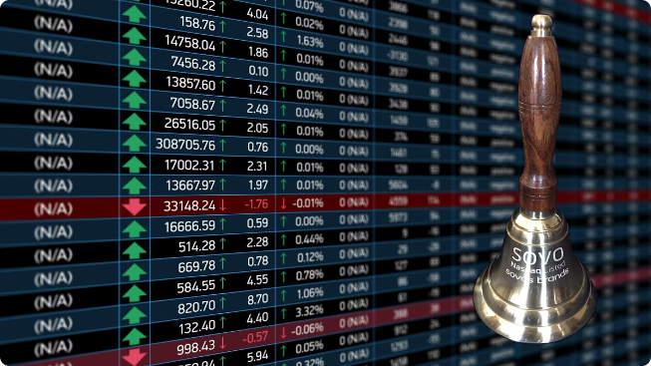
Definition of Primary Market
The primary market is where new securities are issued for the first time. This is the initial offering of shares or bonds directly from the issuer to investors.
1
Initial Public Offerings (IPOs)
2
Debt Issuance
Governments or companies can issue bonds to borrow money from investors, promising to repay principal and interest at a later date.
Companies can raise capital by selling shares to the public for the first time.
3
Private Placements
Securities are sold directly to a limited number of investors, bypassing the public market. This is a more private and targeted method of raising capital.

Slide 3


Examples of Primary Market Transactions
When a company goes public through an IPO, it raises capital by selling shares to investors. This is a primary market transaction. Similarly, when a government issues bonds to finance infrastructure projects, it's a primary market transaction.
Transaction Type
Description
Example
IPO
A company sells shares to the public for the first time.
Google's IPO in 2004.
Debt Issuance
A government or company issues bonds to raise funds.
The US Treasury issuing bonds to finance government operations.
Private Placement
Securities are sold directly to a limited number of investors.
A private company raising funds through a private placement.

Slide 4


Definition of Secondary Market
The secondary market is where existing securities are traded between investors. This market provides liquidity and allows investors to buy and sell securities after they have been initially issued in the primary market.
Exchanges
Over-the-Counter (OTC) Markets
Organized markets where securities are bought and sold through brokers. Examples include the New York Stock Exchange (NYSE) and the Nasdaq.
Decentralized markets where transactions occur directly between two parties, without a central exchange. These markets are typically used for less liquid securities.
Electronic Trading Platforms
Online platforms that facilitate trading of securities, providing a convenient and efficient way for investors to participate in the secondary market.

Slide 5


Examples of Secondary Market Transactions
When you buy shares of a company on the NYSE or Nasdaq, you are participating in a secondary market transaction. The company is not directly involved in this transaction.
1
2
3
Initial Issue
Secondary Market Trading
Company Involvement
A company raises capital by selling shares to investors in the primary market.
Investors trade the previously issued shares among themselves on an exchange or OTC market.
The company does not directly participate in secondary market transactions.

Slide 6
Differences between Primary and Secondary Markets
The primary market involves the initial issuance of securities, while the secondary market involves the trading of existing securities. The primary market focuses on raising capital for issuers, while the secondary market facilitates liquidity for investors.
Primary Market
Secondary Market
New securities are issued.
Existing securities are traded.
Companies and governments raise capital.
Investors buy and sell securities.
Issuer receives proceeds from the sale.
Issuer does not receive proceeds from the sale.

Slide 7

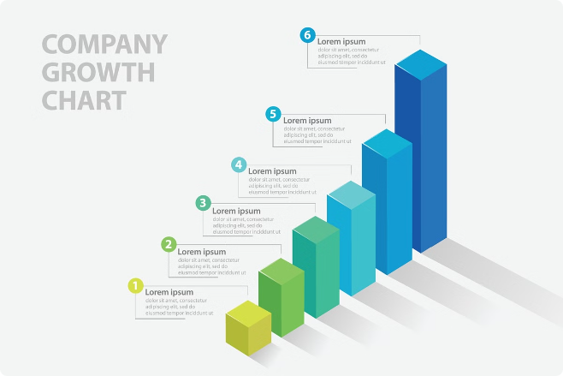




Advantages of Primary Market
The primary market provides a crucial avenue for companies and governments to raise capital. This capital can be used for various purposes, such as funding expansion, research and development, or infrastructure projects.
Capital Formation
Economic Growth
It enables companies to obtain funds needed for growth and innovation.
It contributes to overall economic development by providing capital for investments.
New Ventures
Public Infrastructure
It allows new businesses to enter the market and create jobs.
It enables governments to finance essential projects, such as roads and hospitals.

Slide 8





Advantages of Secondary Market
The secondary market provides liquidity, allowing investors to easily buy and sell securities. This liquidity helps to ensure that investors can readily convert their investments into cash when needed.
Price Discovery
Trading activity in the secondary market helps determine the fair value of securities.
Liquidity
Investors can easily buy and sell securities, ensuring they can access their capital.
Risk Management
Investors can reduce their risk by diversifying their portfolios through trading in the secondary market.

Slide 9
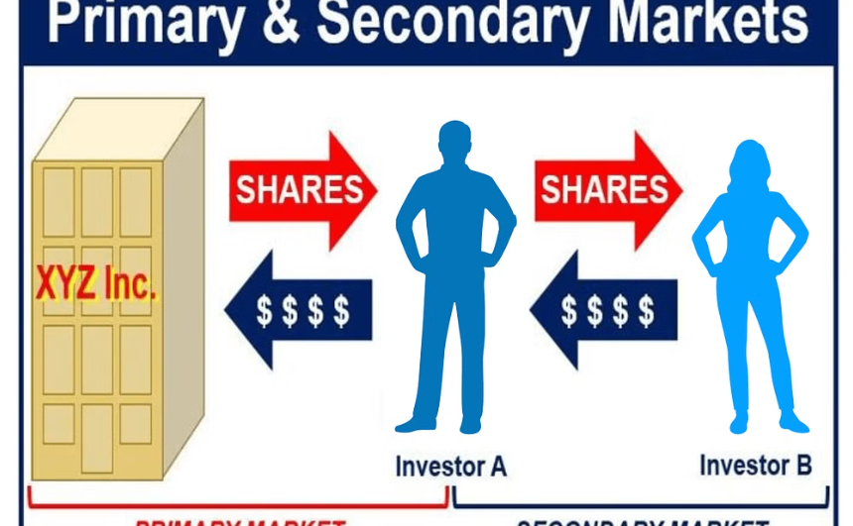
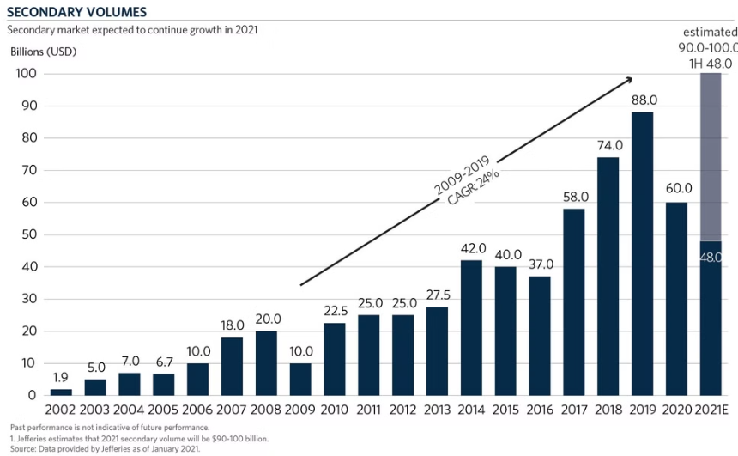
Importance of both Primary and Secondary Markets
Both the primary and secondary markets are essential for the efficient functioning of the financial system. The primary market provides a mechanism for companies and governments to raise capital, while the secondary market provides liquidity for investors.
Primary Market
Secondary Market
Provides capital for new ventures, expansions, and public projects.
Facilitates trading of existing securities, allowing investors to diversify and manage risk.

Slide 10


Conclusion and Key Takeaways
Understanding the difference between primary and secondary markets is crucial for investors and businesses. The primary market allows issuers to raise capital, while the secondary market provides liquidity and price discovery for investors.
Primary markets involve the initial issuance of securities.
Secondary markets involve the trading of existing securities.
Both markets play a vital role in the financial system.

